Slide 1

Cassandra
Workshop 4
Tree Based Statistical Modelling

Slide 2


Slide 3
Two key terms
Before fitting a model with data, we need to ensure two things:-
How to check model generalizability? Ans -> Doing Cross Validation……………
How to measure model performance? Ans -> By knowledge of metrics………..

Slide 4
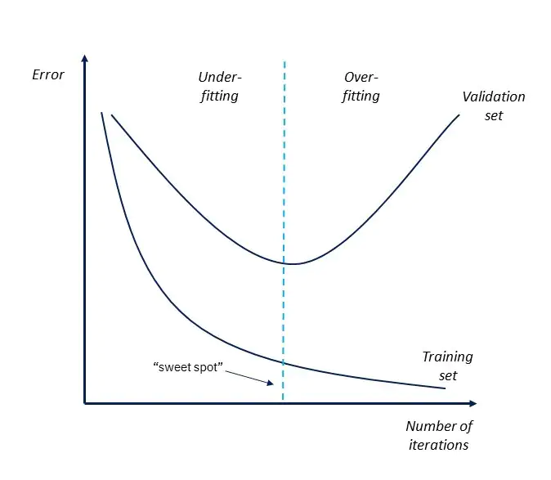
Cross Validation
A way to create a dummy test data => Development set
Checking model performance by comparing against it…
Helps in hyper-parameters selection.

Slide 5
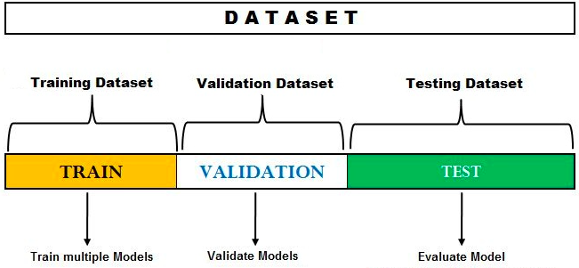
Cross-Val Techniques
METHOD -1 => TRAIN-DEV-TEST SPLIT

Slide 6
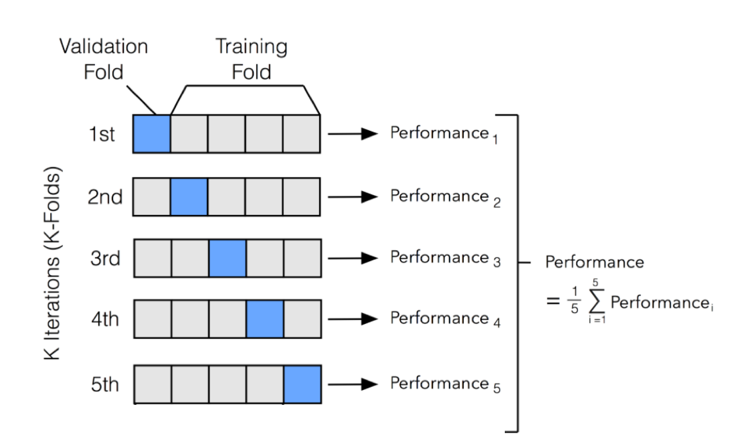
METHOD 2 => K-FOLD CROSS VALIDATION
** A Variant of it is Stratified K-Fold for Classification task.

Slide 7
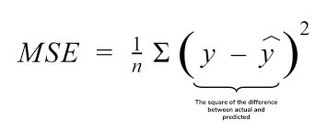
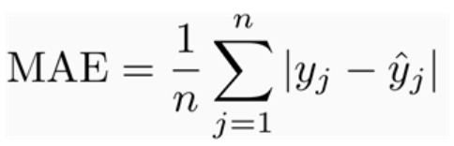
PERFORMANCE
Last Slide mentioned performance, how to check it…….? Ans=> Using Metrics
Definition -> It is basically a scalar entity that defines your model performance.
Some examples are:-
FOR REGRESSION->
MSE (Mean squared error)(L2) =
MAE (Mean absolute error)(L1) =

Slide 8
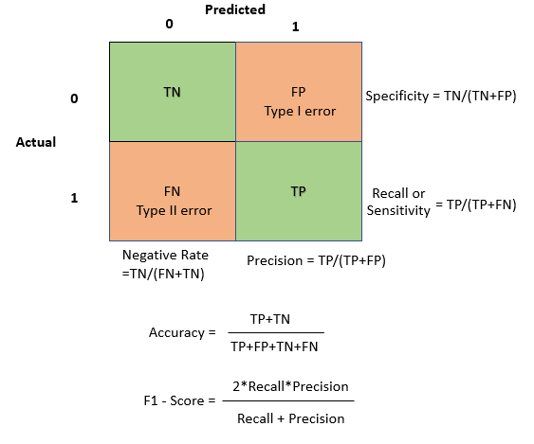
For Classification->

Slide 9
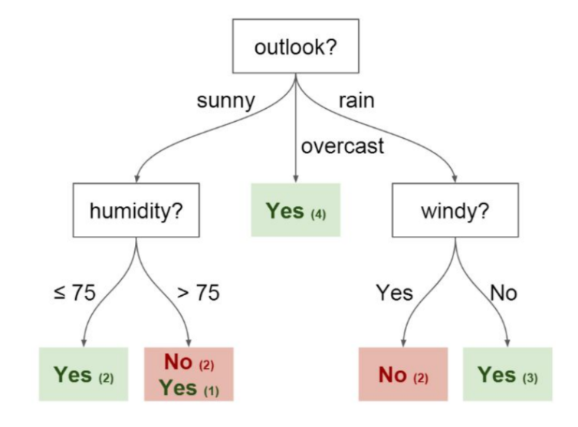
DECISION TREE

Slide 10
What is Decision Tree?
A Decision Tree algorithm is one of the most popular machine learning algorithms. It uses a tree like structure and their possible combinations to solve a particular problem. It belongs to the class of supervised learning algorithms where it can be used for both classification and regression purposes.Decision Trees are an important type of algorithm for predictive modeling machine learning.Nowadays, Decision Tree algorithm is known by its modern name CART which stands for Classification and Regression Trees.

Slide 11
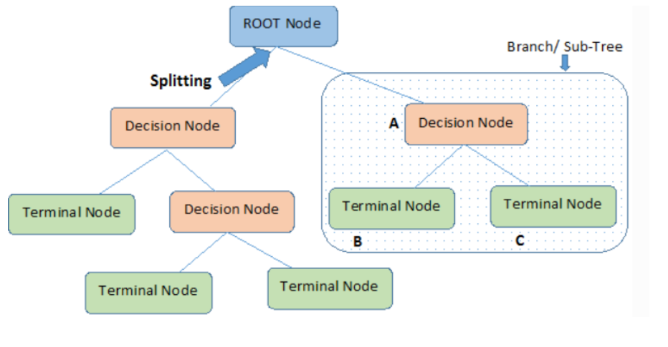
Decision Tree Algorithm Terminology

Slide 12
Lets understand some important ones!
Root Node- it represents the entire population or sample. This further gets divided into two or more nodes.
Decision Node-When a sub-node splits into further sub-nodes, then it is called a decision node.
Leaf/Terminal Node-Nodes that do not split are called Leaf or Terminal nodes.
.

Slide 13
Splitting vs Pruning
Splitting-It is a process of dividing a node into two or more sub-nodes.
Pruning-When we remove sub-nodes of a decision node, this process is called pruning. It is the opposite process of splitting.

Slide 14
Decision Tree Algorithm Intuition
1-For each attribute in the dataset, the Decision-Tree algorithm forms a node. The most important attribute is placed at the root node.
2-For evaluating the task in hand, we start at the root node and we work our way down the tree by following the corresponding node that meets our condition or decision.
3-This process continues until a leaf node is reached. It contains the prediction or the outcome of the Decision Tree.

Slide 15
Attribute Selection Measures
The primary challenge in the Decision Tree implementation is to identify the attributes which we consider as the root node and each level. This process is known as the attributes selection.
There are 2 popular attribute selection measures. They are as follows:-
Information gain
Gini index
While using Information gain as a criterion, we assume attributes to be categorical and for Gini index attributes are assumed to be continuous.

Slide 16
Entropy and Information gain
Entropy measures the impurity in the given dataset. In Physics and Mathematics, entropy is referred to as the randomness or uncertainty of a random variable X.
Information gain is the decrease in entropy. Information gain computes the difference between entropy before split and average entropy after split of the dataset based on given attribute values.

Slide 17
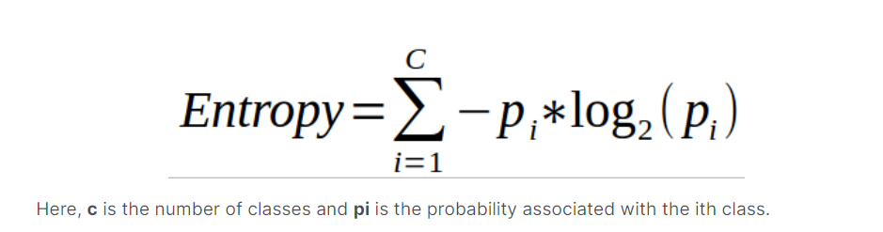
How Entropy is Calculated?

Slide 18
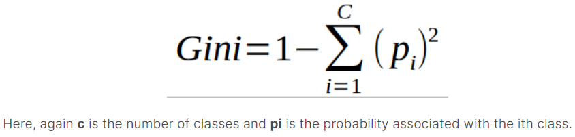
Gini Index
measures impurity: a node is “pure” (gini=0) if all training instances it applies to belong to the same class.

Slide 19
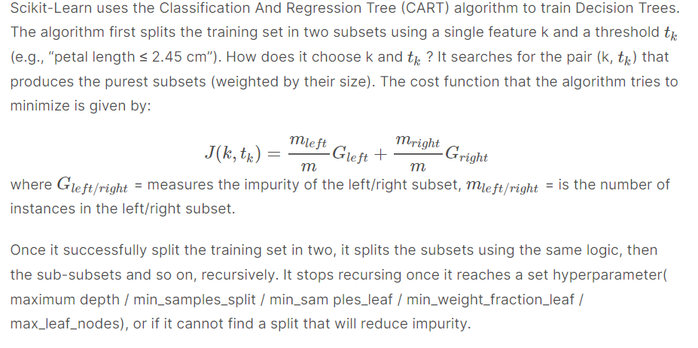
CART Training Algorithm

Slide 20
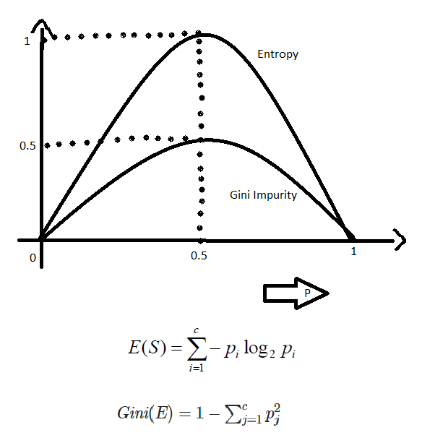
Gini Vs Entropy
Most of the time it does not make a big difference: they lead to similar trees. Gini impurity is slightly faster to compute, so it is a good default.

Slide 21
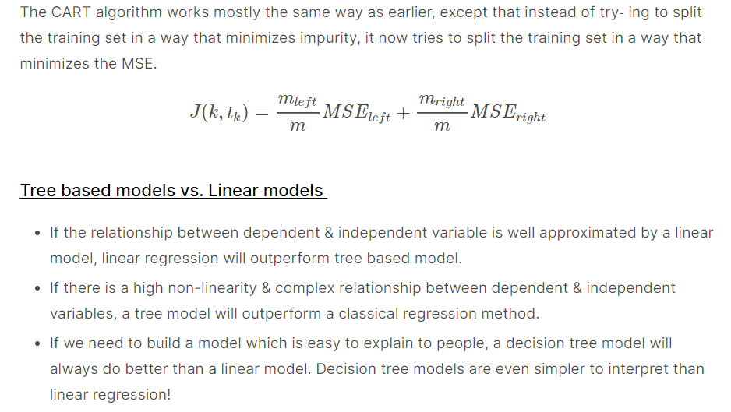
Regression Tree

Slide 22
Overfitting in Decision Tree algorithm
Overfitting is a practical problem while building a Decision-Tree model. The problem of overfitting is considered when the algorithm continues to go deeper and deeper to reduce the training-set error but results with an increased test-set error. So, accuracy of prediction for our model goes down.
Two approaches which can be used to avoid overfitting are as follows:-
Pre-Pruning
Post-Pruning

Slide 23
Parameters
criterion: The function to measure the quality of a split. Supported criteria are "gini" for the Gini impurity and "entropy" for the information gain.
splitter: The strategy used to choose the split at each node. Supported strategies are "best" to choose the best split and "random" to choose the best random split.
max_depth: The maximum depth of the tree. If None, then nodes are expanded until all leaves are pure or until all leaves contain less than min_samples_split samples.
min_samples_split: The minimum number of samples required to split an internal node.

Slide 24
min_samples_leaf: The minimum number of samples required to be at a leaf node. A split point at any depth will only be considered if it leaves at least min_samples_leaf training samples in each of the left and right branches. This may have the effect of smoothing the model, especially in regression.
max_leaf_nodes: Grow a tree with max_leaf_nodes in best-first fashion. Best nodes are defined as relative reduction in impurity. If None then unlimited number of leaf nodes.
min_impurity_decrease: A node will be split if this split induces a decrease of the impurity greater than or equal to this value.
min_impurity_split: Threshold for early stopping in tree growth. A node will split if its impurity is above the threshold, otherwise it is a leaf.

Slide 25
Advantages Vs Disadvantages
Advantages
Useful in data exploration.
Less data cleaning required
Datatype is not constraint.
Easy to understand
Disadvantages
Overfitting.
Cannot guarantee to return the globally optimal decision tree.

Slide 26
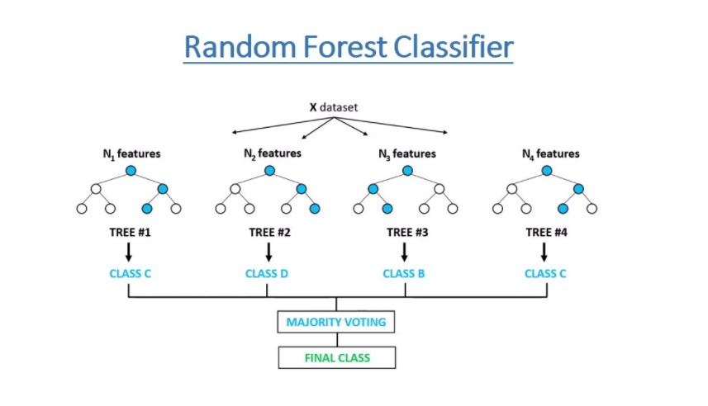
Random Forest

Slide 27
Definition
Random forest is a supervised learning algorithm. It has two variations – one is used for classification problems and other is used for regression problems. It is one of the most flexible and easy to use algorithm. It creates decision trees on the given data samples, gets prediction from each tree and selects the best solution by means of voting. It is also a pretty good indicator of feature importance.
Random forest algorithm combines multiple decision-trees, resulting in a forest of trees, hence the name Random Forest. In the random forest classifier, the higher the number of trees in the forest results in higher accuracy.

Slide 28
Random Forest Algorithm Intuition
Random subsets are created from the original dataset (bootstrapping).
At each node in the decision tree, only a random set of features are considered to decide the best split.
A decision tree model is fitted on each of the subsets.
The final prediction is calculated by averaging the predictions from all decision trees.

Slide 29
Advantages
Random forest algorithm can be used to solve both classification and regression problems.
It is considered as very accurate and robust model because it uses large number of decision-trees to make predictions.
Random forests takes the average of all the predictions made by the decision-trees, which cancels out the biases. So, it does not suffer from the overfitting problem.
Random forest classifier can be used for feature selection. It means selecting the most important features out of the available features from the training dataset.

Slide 30
Disadvantages
The biggest disadvantage of random forests is its computational complexity. Random forests is very slow in making predictions because large number of decision-trees are used to make predictions. All the trees in the forest have to make a prediction for the same input and then perform voting on it. So, it is a time-consuming process.
The model is difficult to interpret as compared to a decision-tree, where we can easily make a prediction as compared to a decision-tree.

Slide 31
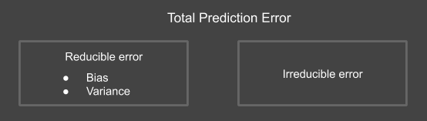
Type of errors
Type of errors:
Total Prediction error= Bias² + Variance + Irreducible error

Slide 32
Bias and Variance
Bias:
Bias means strong inclination towards something.
Bias error is the error in assumption of the target function.
Bias results in overlooking of features in data set and hence not allowing the model to adapt with the training data fully.
Low Bias- Fewer assumptions about the target functions are made. Ex- KNN, Decision Tree etc.
High Bias- More assumptions about the target function are made. Ex- Multiple Linear Regression, Logistic Regression etc.
Variance:
Variance signifies the difference in fits between datasets.
Variance error occurs when the model parameters are too much influenced by the training data and significant change occurs for performing on different datasets.
Low Variance- When changes are minimal in model parameters for performing on different dataset. Ex- Linear Regression
High Variance- When model parameters have a significant amount of change for performing on different datasets. Ex- SVM, Decision Tree etc.

Slide 33
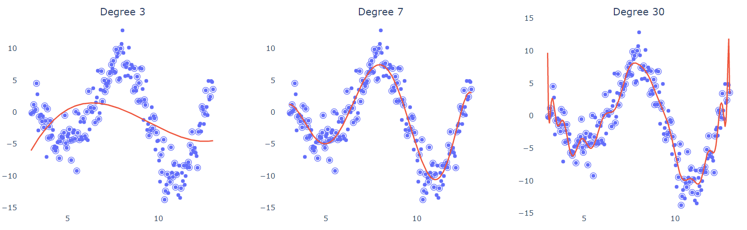
Bias vs Variance
Bias-Variance Plots
Here in this image first plot has low variance but high bias, second plot has a balance between bias and variance and third plot has low bias but high variance.

Slide 34
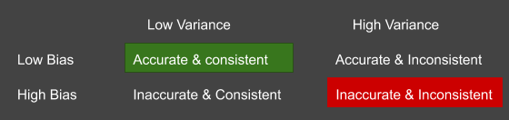

Bias Variance Tradeoff
To find a better model it should have low bias and low variance. But finding that is difficult.
If the model tries to adapt well with the training data it can be overfitted on that data and perform bad on a different data which indicates high variance.
If the model tries to be generalised over different datasets then it will have low variance but it may miss some important information of the training data which will occur in high bias.
So we need to find a balance between these two errors.

Slide 35
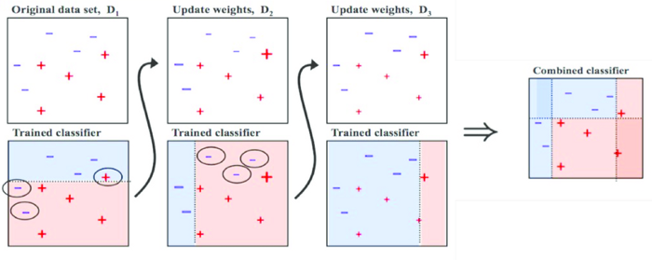
Boosting Algorithm
Boosting algorithms are methods that train a family of weak learners and later combine them to make a strong classifier.
Working of Boosting Algorithms:
Let's say we have a dataset d. Now we take a weak learner A and trained it on d. Some labels are predicted correctly and others incorrectly.
Now weighted the dataset in a way that the labels predicted wrong are now have more weights so they will maximise the loss if predicted wrong again. Now we have taken a learner B and trained it on d again.
This process repeats for several epochs and combining all these weak learners a strong learner made.
Now for prediction the data passed through all these one by one which will give a better output.
Generally different Boosting algorithms differ in the weighting method. Ex- AdaBoost, GBM, LGBM etc.

Slide 36
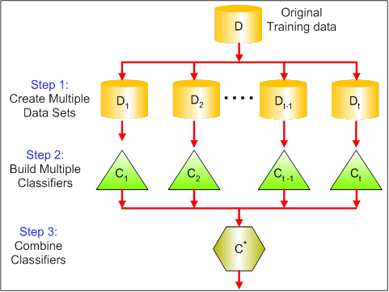
Bagging Algorithms
Bagging is an ensembling method which is used for reducing variance by combining the predictions of multiple classifiers trained on different subsamples of the same dataset.
Working of Bagging Algorithms:
Firstly multiple sub samples of the same dataset are created for training and validating.
Then multiple classifiers are trained. Each classifier is trained on one sample but validated on the other sample.
After training they are ensembled to get better prediction. For classification the prediction with maximum votes are chosen as the output and in case of regression generally the average is the output.
Common Bagging algorithms are Bagging meta-estimator, Random Forest etc.

Slide 37
REFERENCES
Article - Different Cross Validation Techniques (open in incognito tab)
Different metrics implementation in sklearn
A Guide to Decision Trees for Beginners
StatQuest: Decision Trees
Decision-Tree Classifier Tutorial
Random Forest Classifier Tutorial
Bias and Variance(Open in Incognito)
Ensemble Methods

